Slide 1
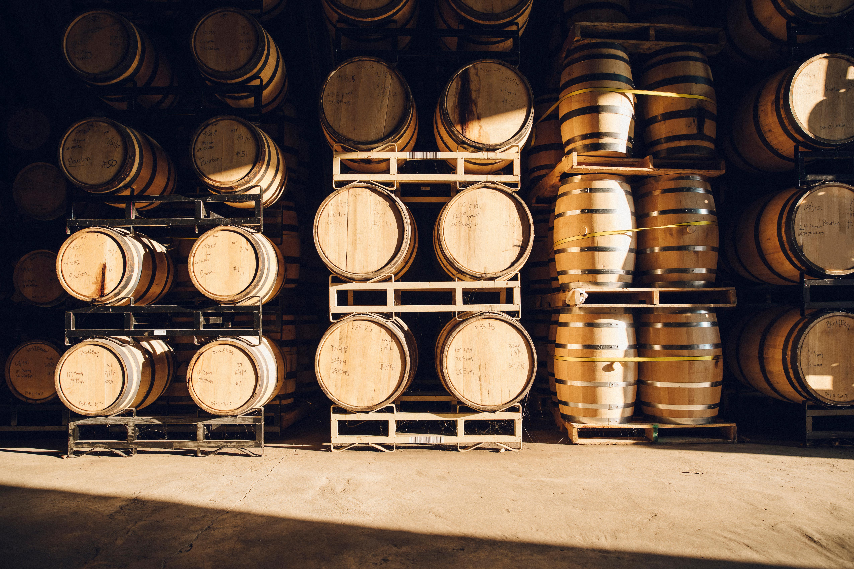
Wine quality prediction model Brianna Beyer | Denis Dragan | Summer Dowdy | Jason Hinshaw

Slide 2
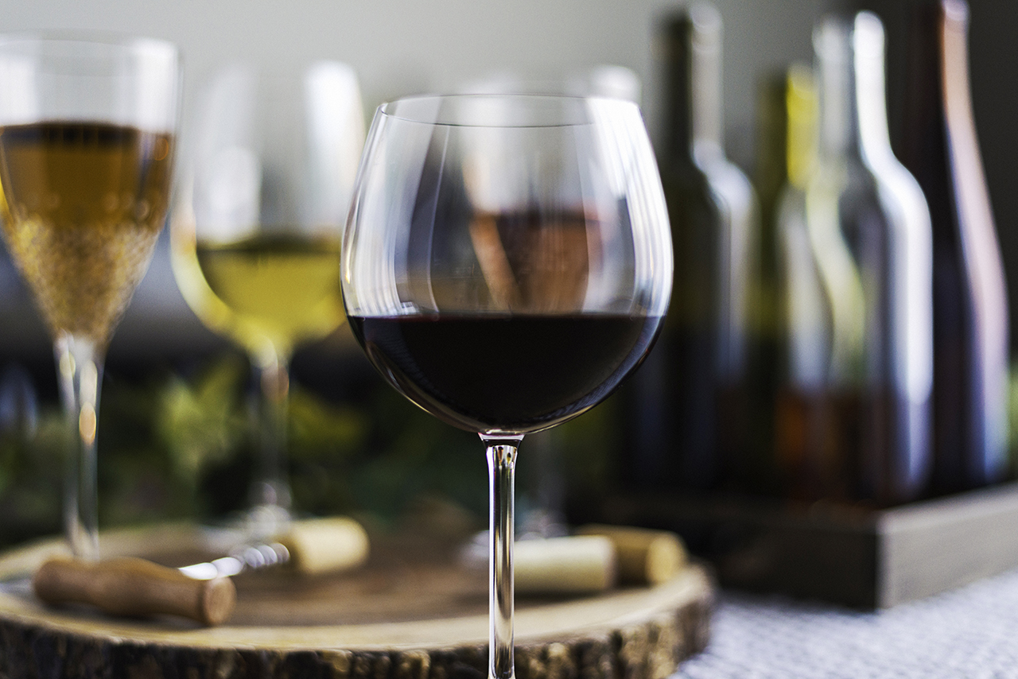
overview
Why we chose wine quality
The purpose of this project is to provide accurate wine quality predictions based on physiochemical properties using neural network and random forest models.

Slide 3

Wine 101
How is wine made?
What are the types of wine?
What are wine varietals?
What is an appellation?
What makes wine good? bad?

Slide 4
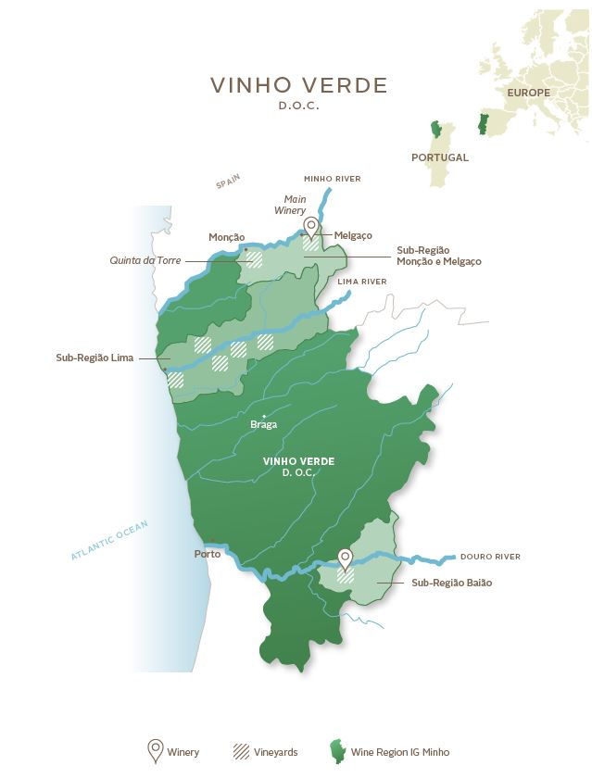
the Datasets
UC Irvine Machine Learning Repository based on data from the 2009 paper, Modeling wine preferences by data mining from physicochemical properties.
2 Datasets: Red Wine & White Wine
1,599 red data points / 4,898 data points
Data collected from Vinho Verde region in the northwest of Portugal
Each wine was analyzed, and quality assessed between 2004 and 2007 by the Viticulture Commission of the Vinho Verde Region.
Variables: 11 physiochemical properties & quality score
UC Irvine Wine Quality Datasets
Modeling Wine Preferences Paper

Slide 5
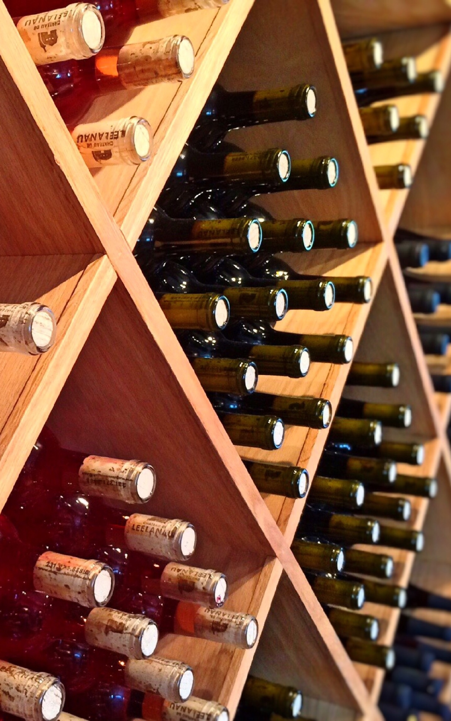
Variables
Fixed Acidity
Volatile Acidity
Citric Acid
Residual Sugar
Chlorides
Free Sulfur Dioxide
Total Sulfur Dioxide
Density
pH
Sulphates
Alcohol
Quality Score between 0 and 10
0 to 3 = Low
4 to 6 = Average
7 to 10 = High

Slide 6
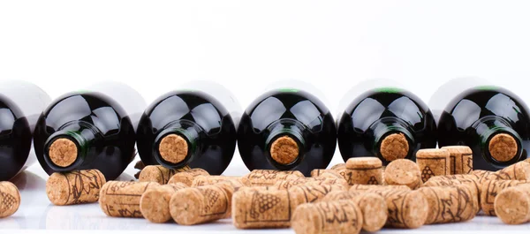
Neural Network model
Reason behind choosing model?
Process of optimizing model?

Slide 7

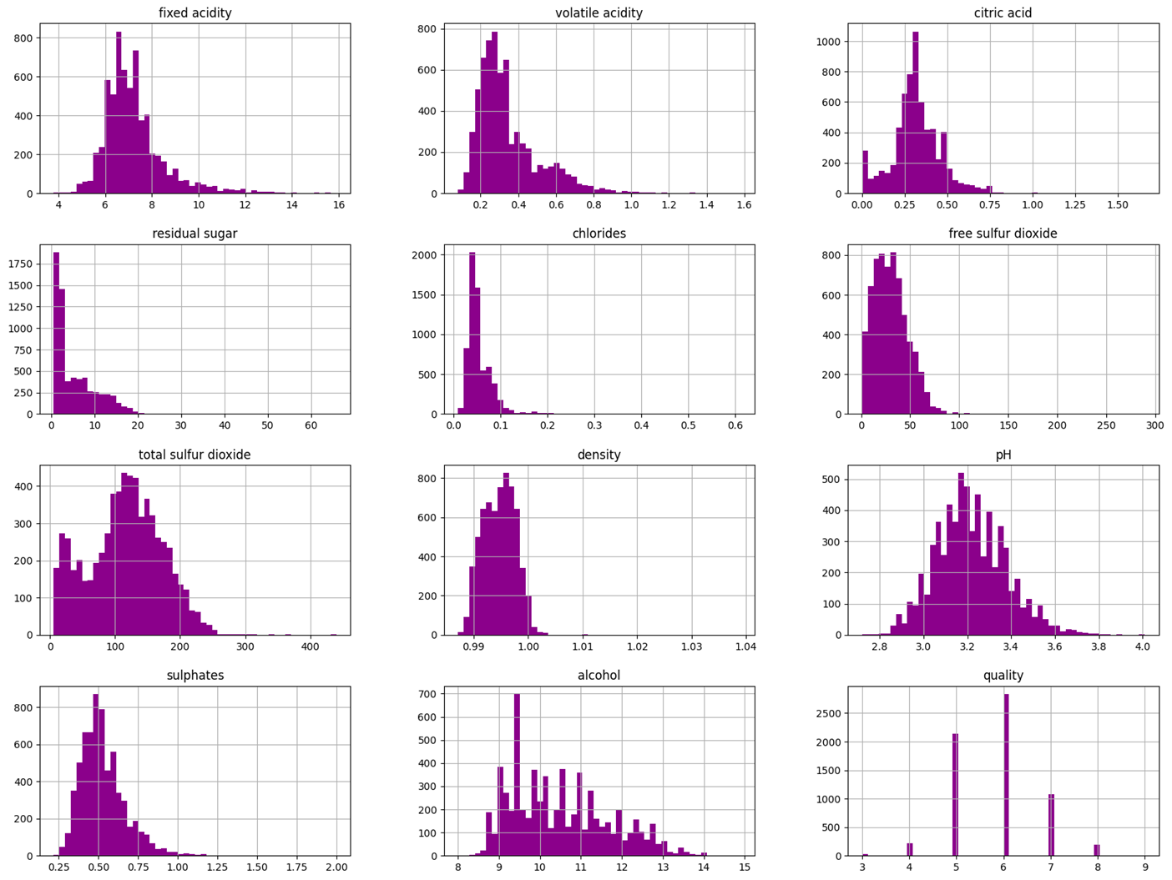
Variable histogram

Slide 8
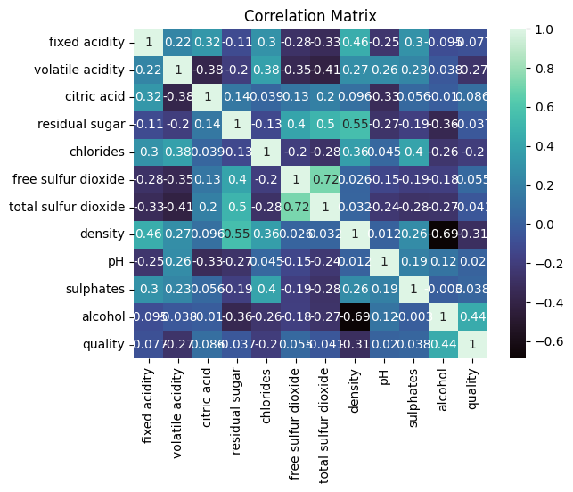
Correlation matrix

Slide 9

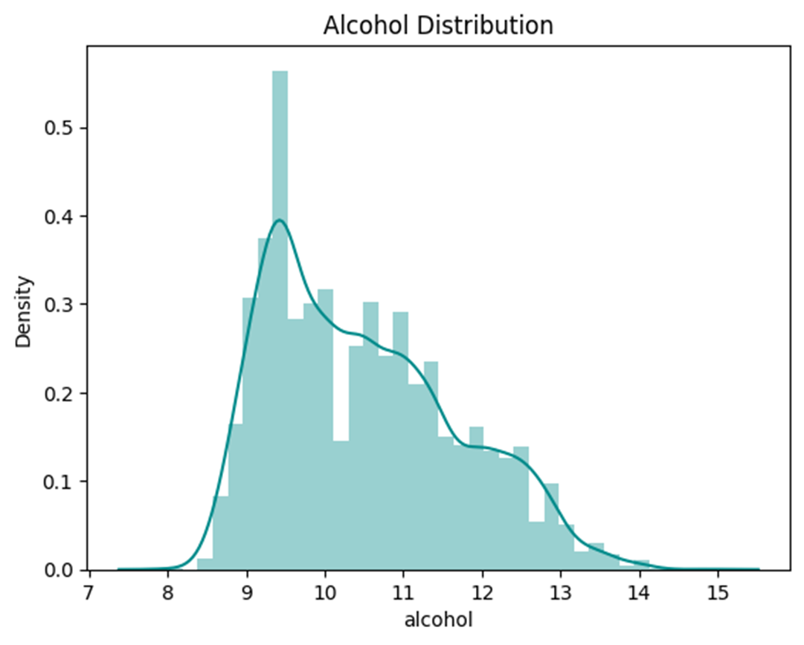
Alcohol distribution

Slide 10
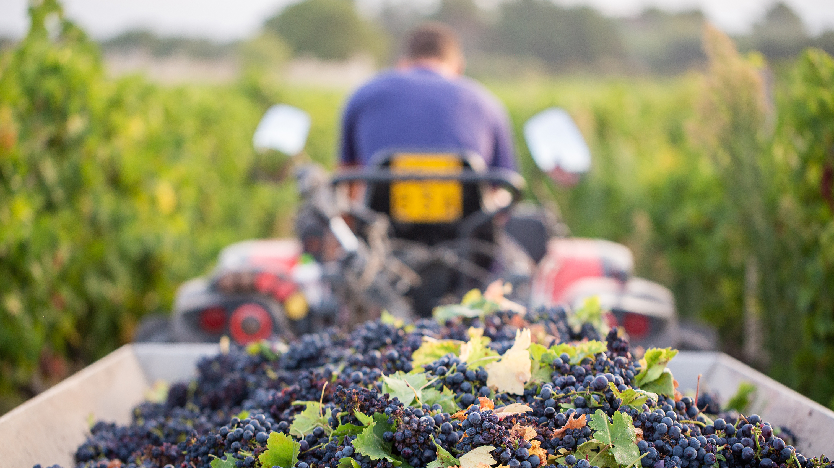
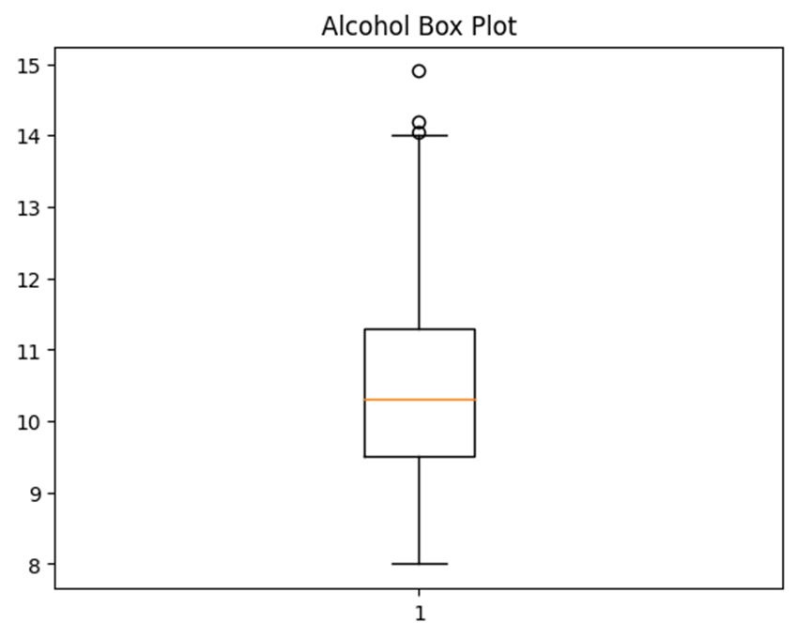
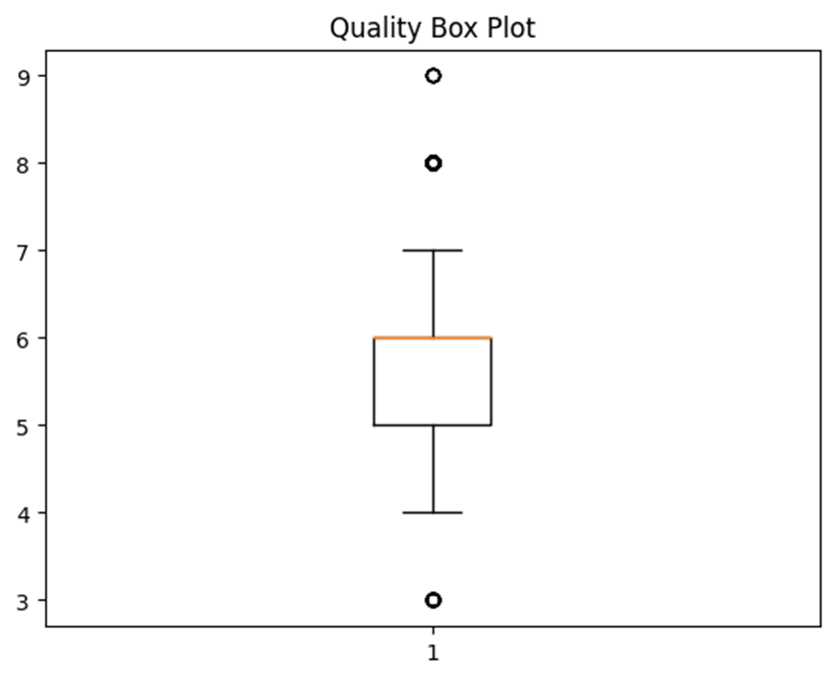
Alcohol & Quality box plots

Slide 11
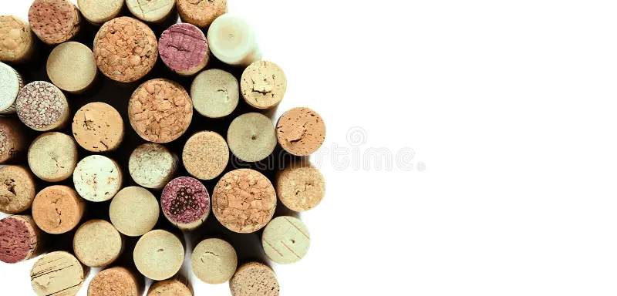
Nn Model Results
MODEL | ACCURACY | LOSS
White Wine NN | 0.998 | 0.011
Red Wine NN | 0.757 | 0.618
Combined NN *w/ Quality Category | 0.947 | 0.144
Combined NN *w/o Quality Category | 0.556 | 1.037

Slide 12
Random forest model
Reason we chose this model?
Process of optimizing model

Slide 13
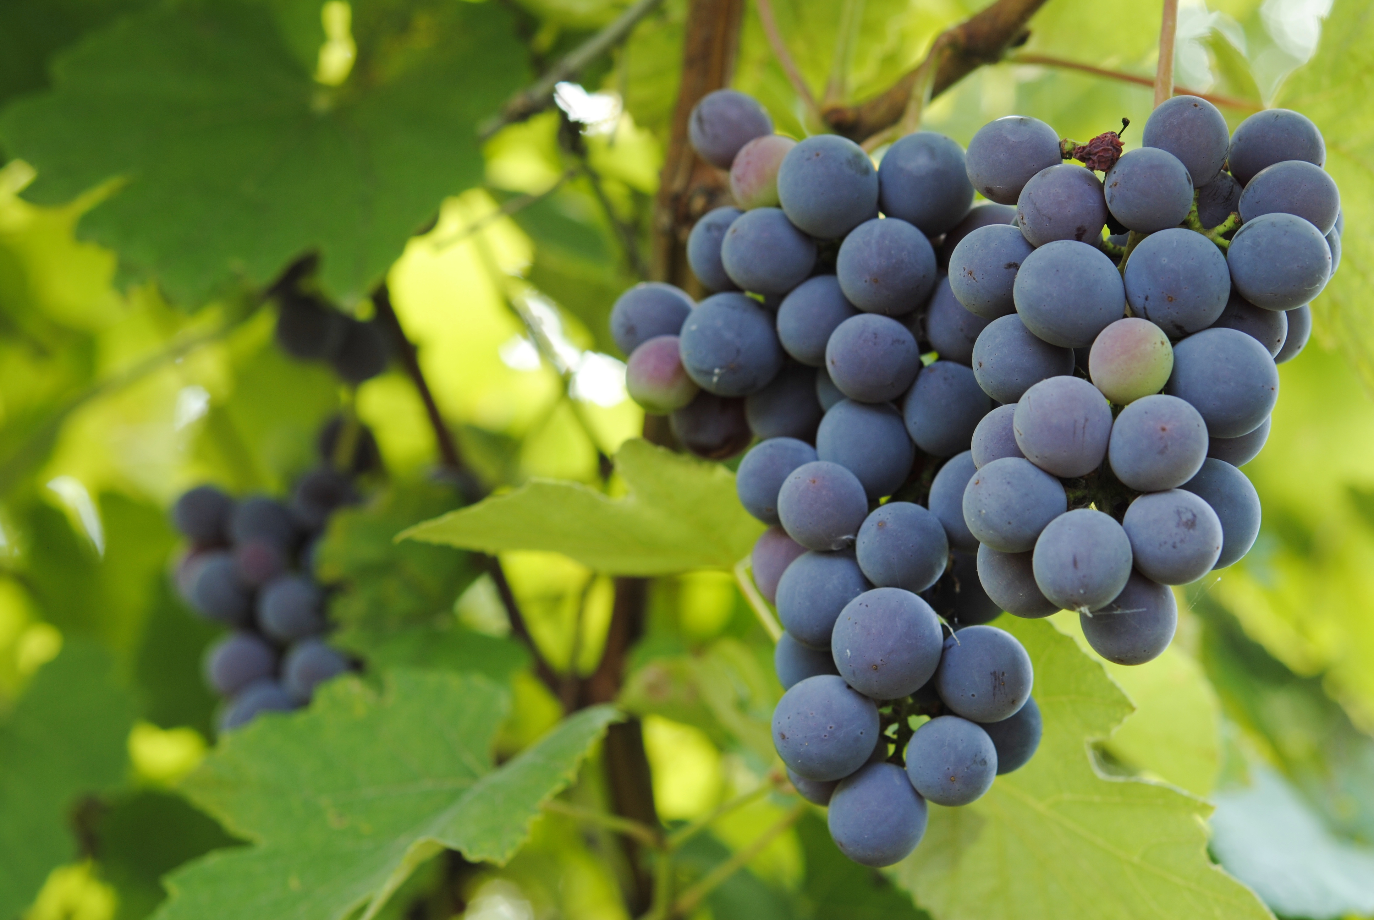
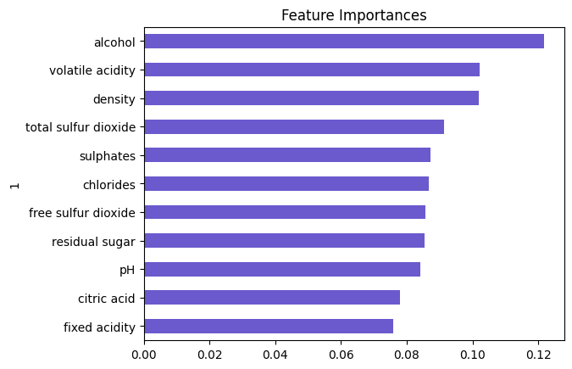
Feature importance

Slide 14

RF CLASSIFICATION REPORT
Classification Report
precision | recall | f1-score | support
3 0.00 0.00 0.00 9
4 0.00 0.00 0.00 64
5 0.00 0.00 0.00 550
6 0.42 1.00 0.59 680
7 0.00 0.00 0.00 285
8 0.00 0.00 0.00 34
9 0.00 0.00 0.00 3
accuracy 0.42 1625
macro avg 0.06 0.14 0.08 1625
weighted avg 0.18 0.42 0.25 1625

Slide 15
rf Model Results
MODEL | TECHNIQUE | ACCURACY
Combined RF | w/ RandomSampler | 0.689
Combined RF | w/o RandomSampler | 0.418

Slide 16
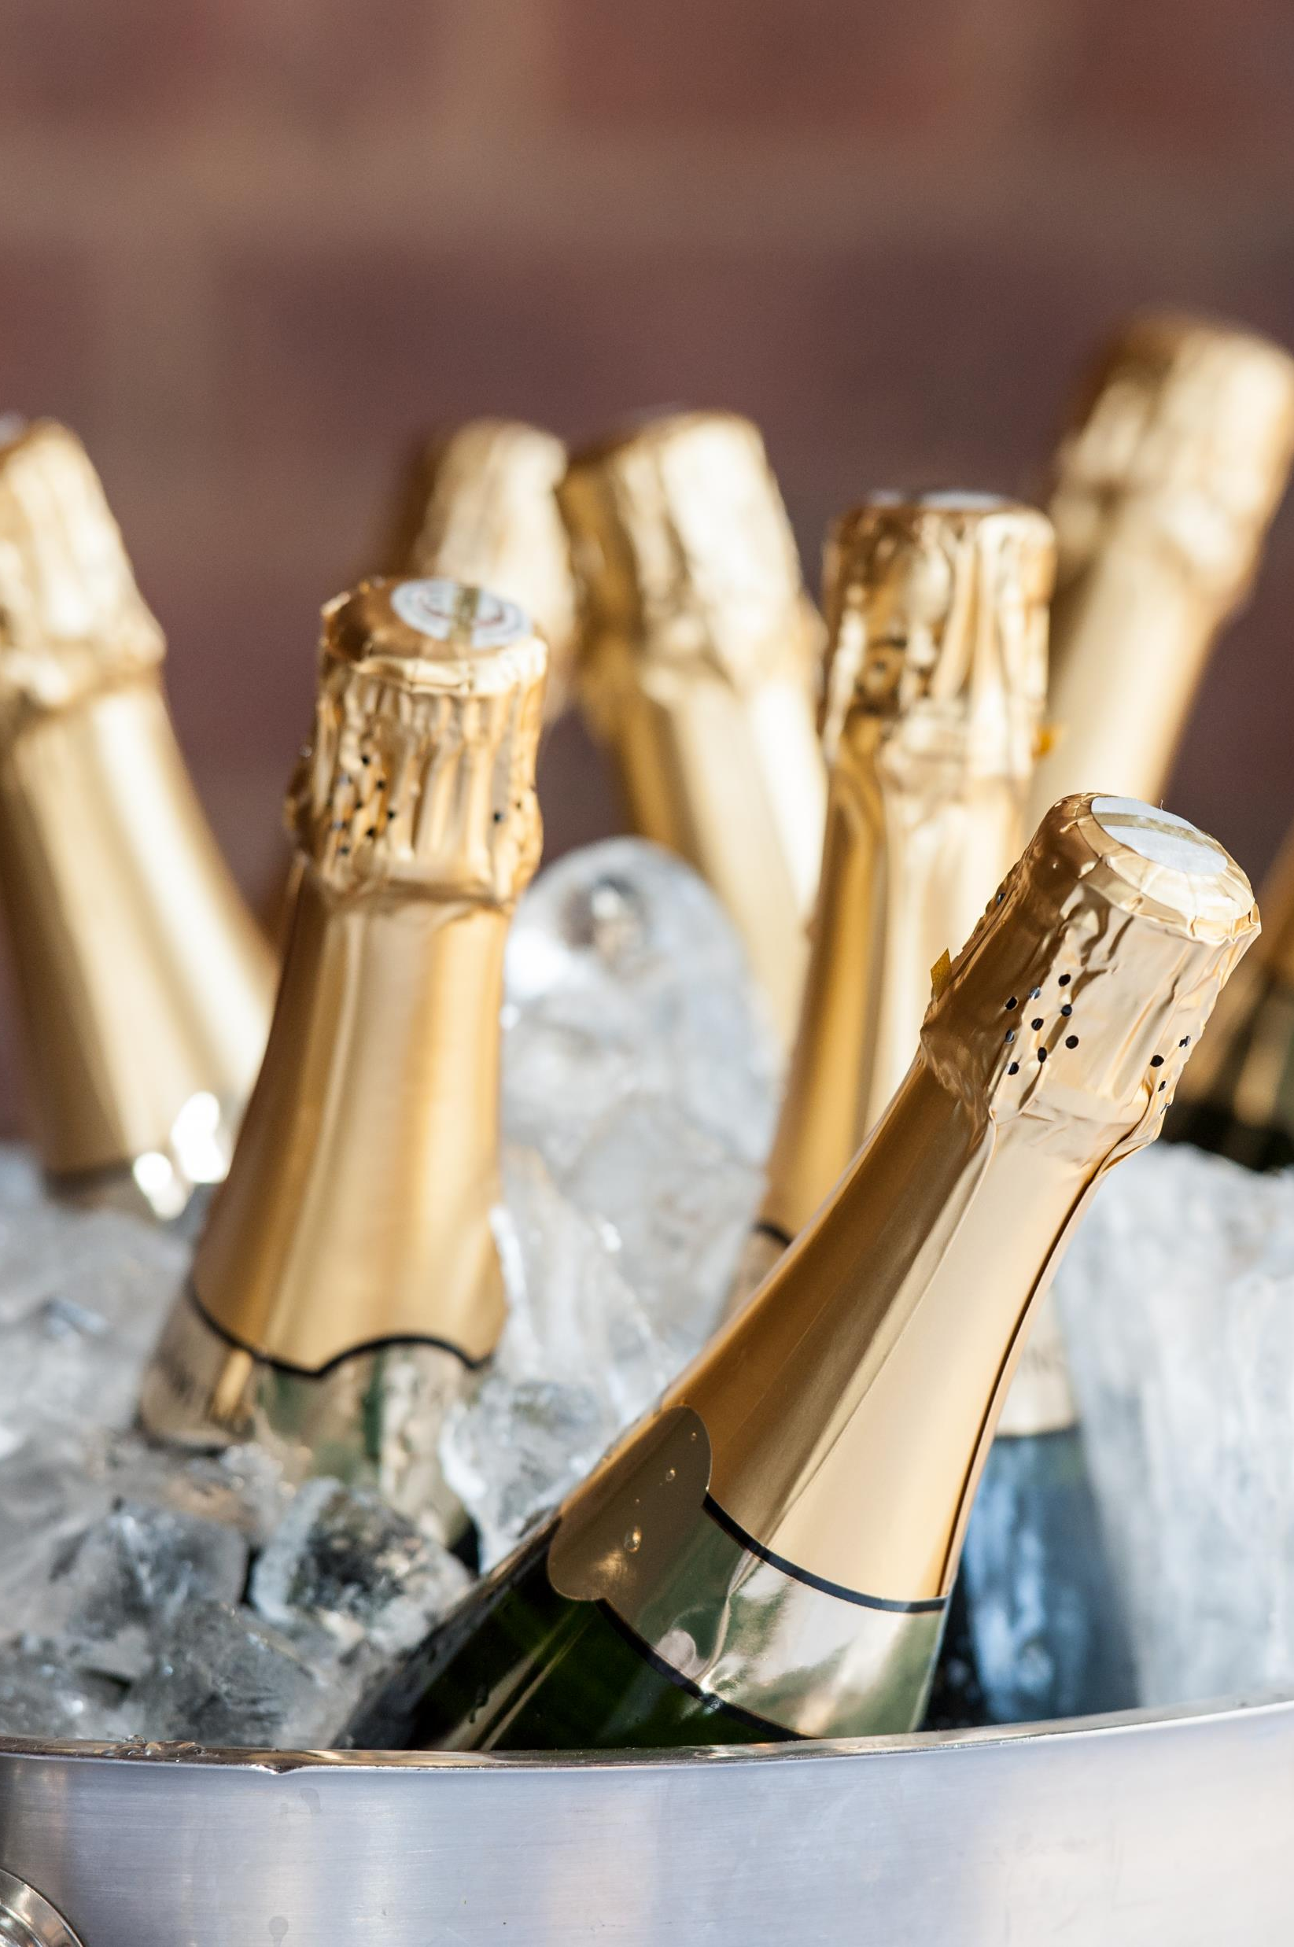
summary

Slide 17
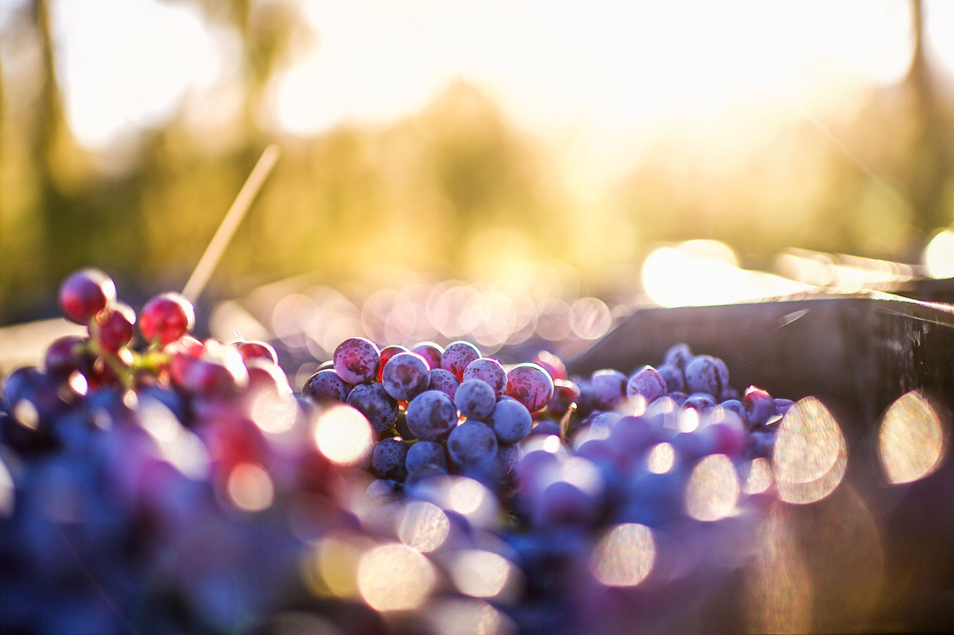
References
Cortez, Paulo, et al. “Modeling Wine Preferences by Data Mining from Physicochemical Properties.” _Decision Support Systems_, vol. 47, no. 4, Nov. 2009, pp. 547–553, https://doi.org/10.1016/j.dss.2009.05.016.
Diehm, Jan, and Lars Verspohl. “Wine & Math: A Model Pairing.” _The Pudding_, 2021, pudding.cool/2021/03/wine-model/. Accessed 5 Sept. 2024.
Parrish, Michael. “What Are Wine Varietals? Comprehensive Guide to Grape Varieties | the Tasting Alliance | the Tasting Alliance.” _The Tasting Alliance_, 14 Mar. 2024, thetastingalliance.com/what-are-wine-varietals-comprehensive-guide-to-grape-varieties/. Accessed 5 Sept. 2024.
Schull, Trista. “How Wine Is Made,” _Witches Falls Winery_, 7 Sept. 2022, witchesfalls.com.au/blogs/news/how-wine-is-made. Accessed 6 Sept. 2024.
The Wine Wankers. “A Great Collection of Wine Infographics,” _The Wine Wankers_, 12 Feb. 2014, winewankers.com/2014/02/12/a-great-collection-of-wine-infographics/. Accessed 5 Sept. 2024.
Theethat Anuraksoontorn. “Wine Quality Prediction with Python - Analytics Vidhya - Medium.” _Medium_, Analytics Vidhya, 21 Sept. 2020, medium.com/analytics-vidhya/wine-quality-prediction-with-python-695939d34d87. Accessed 5 Sept. 2024.
Wine Paths. “The Ultimate Beginners Guide to Wine.” _Www.winepaths.com_, www.winepaths.com/articles/editorial/wine-guide/the-ultimate-beginners-guide-to-wine. Accessed 5 Sept. 2024.

Slide 18
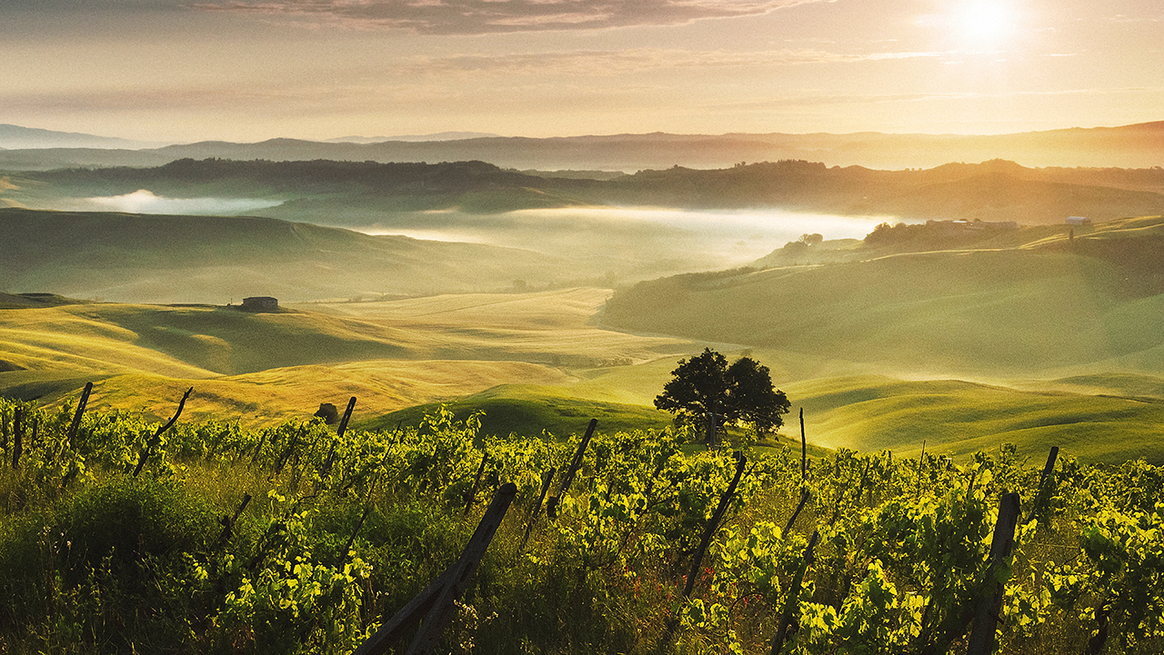
Thank you!

